Slide 1






PowerShell Conference Asia
Designing Azure Resource Manager Templates
Ritesh Modi

Slide 2
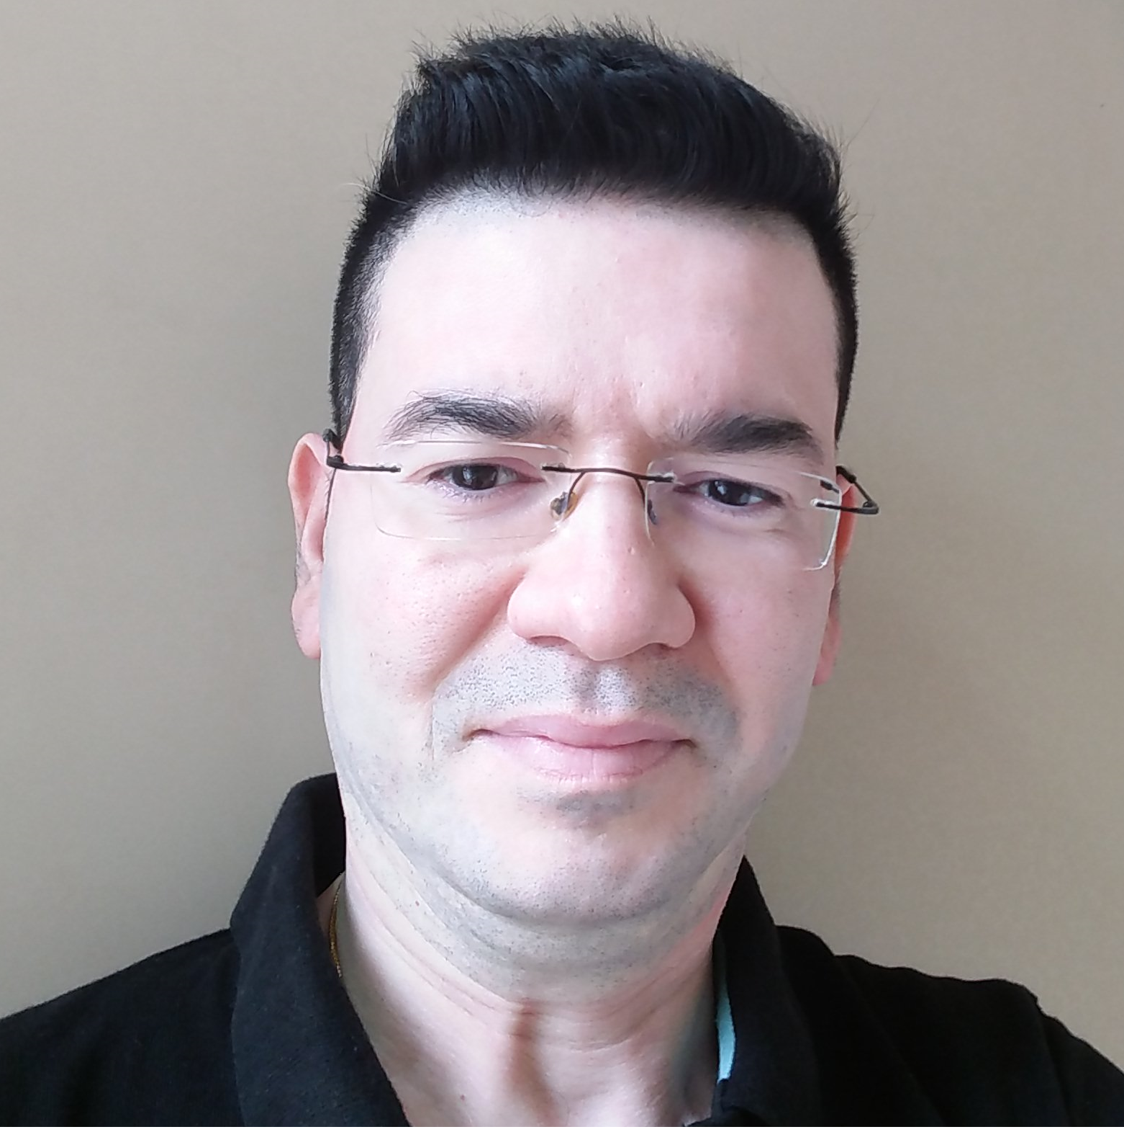



About me
Ritesh Modi
Ex-Microsoft
Senior Technical Evangelist
http://automationnext.wordpress.com
@automationnext
https://www.linkedin.com/in/ritesh-modi

Slide 3
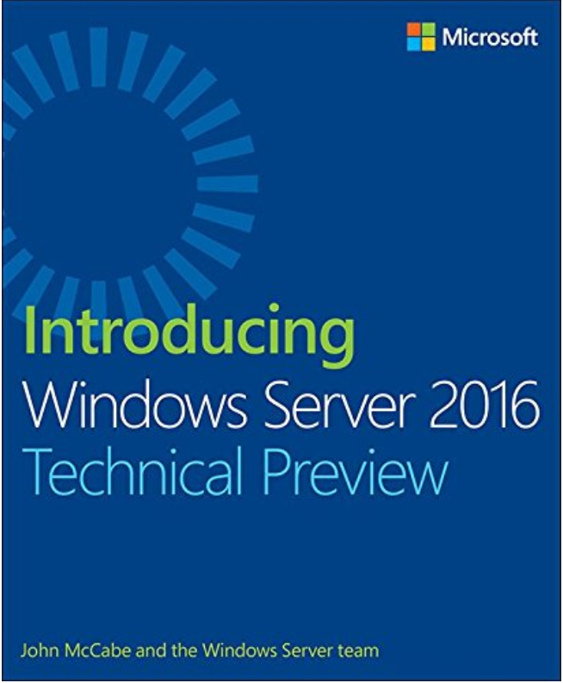
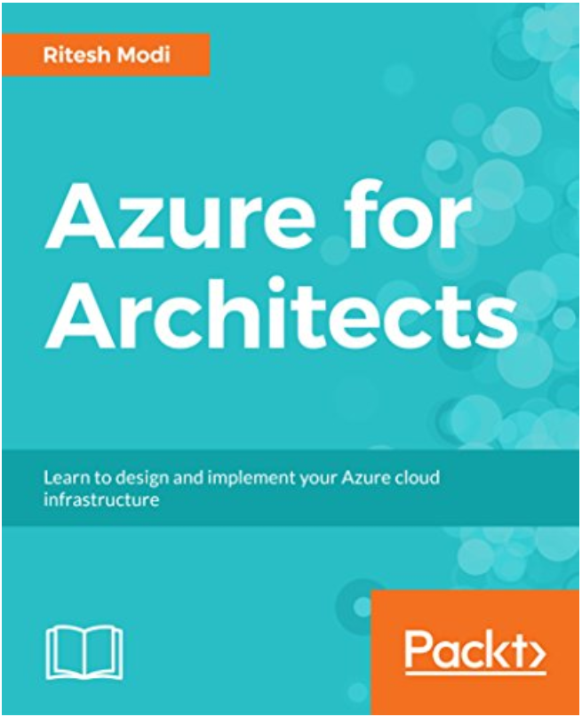
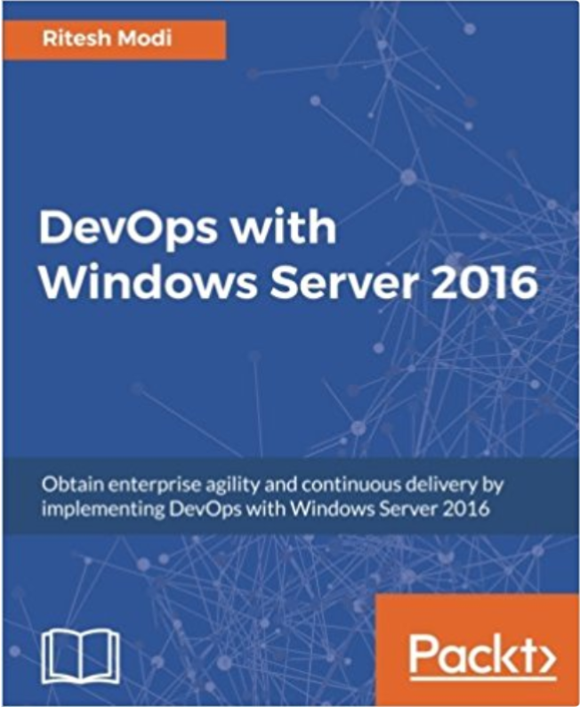
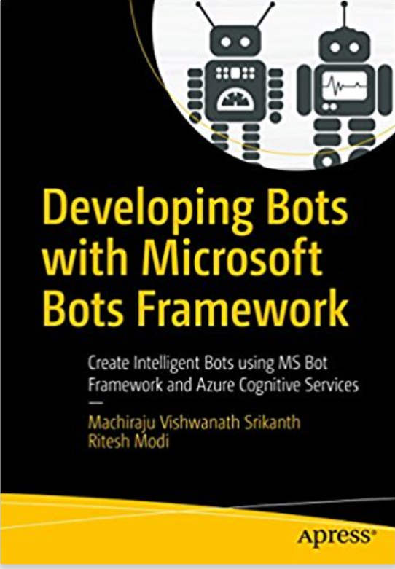

A bit more about me
Blockchain, AI, Infrastructure, Azure and DevOps architect
Author of multiple books
Author for MSDN Magazine
Speaker at national and international conferences
Technology enthusiast and avid blogger
PowerShell Conference
Singapore 2017

Slide 4
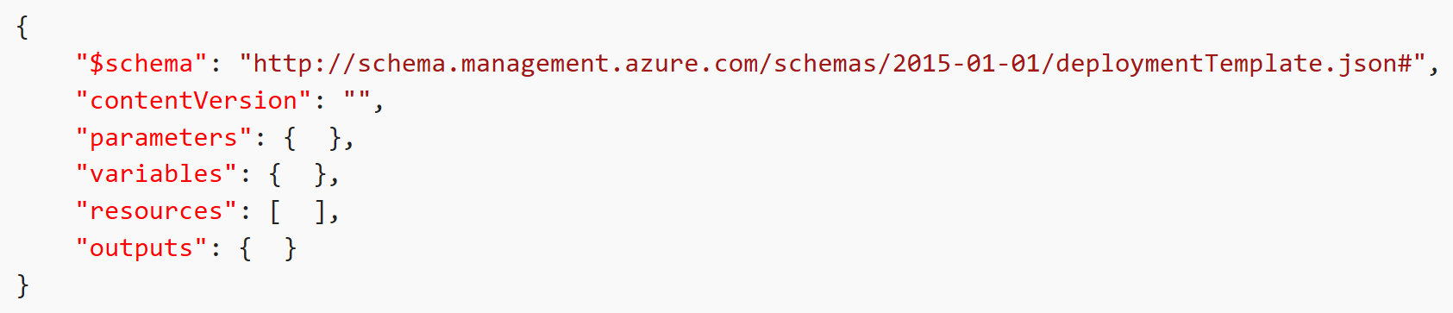
Template Format

Slide 5
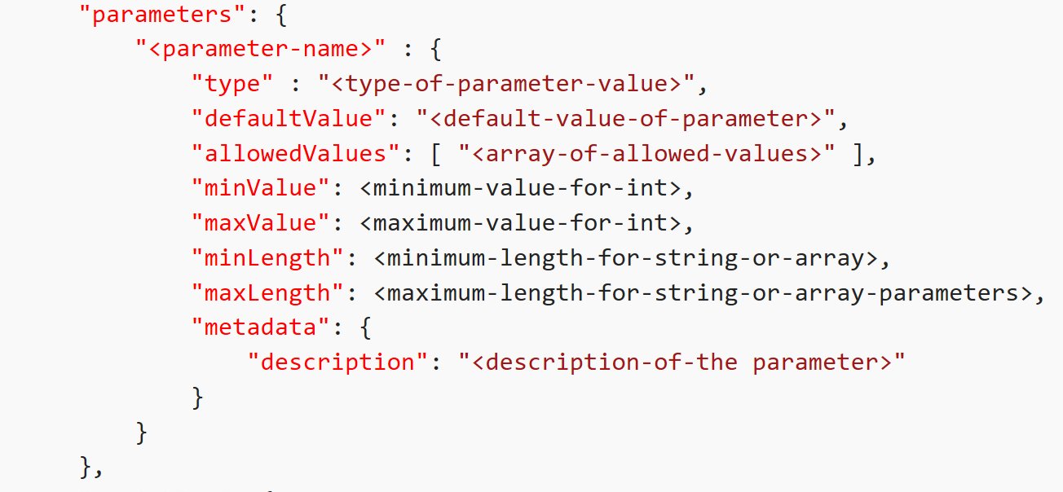
Parameters

Slide 6
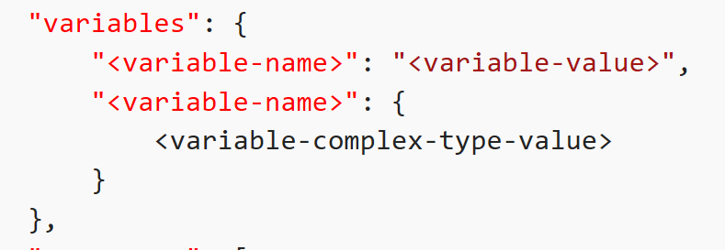
Variables

Slide 7
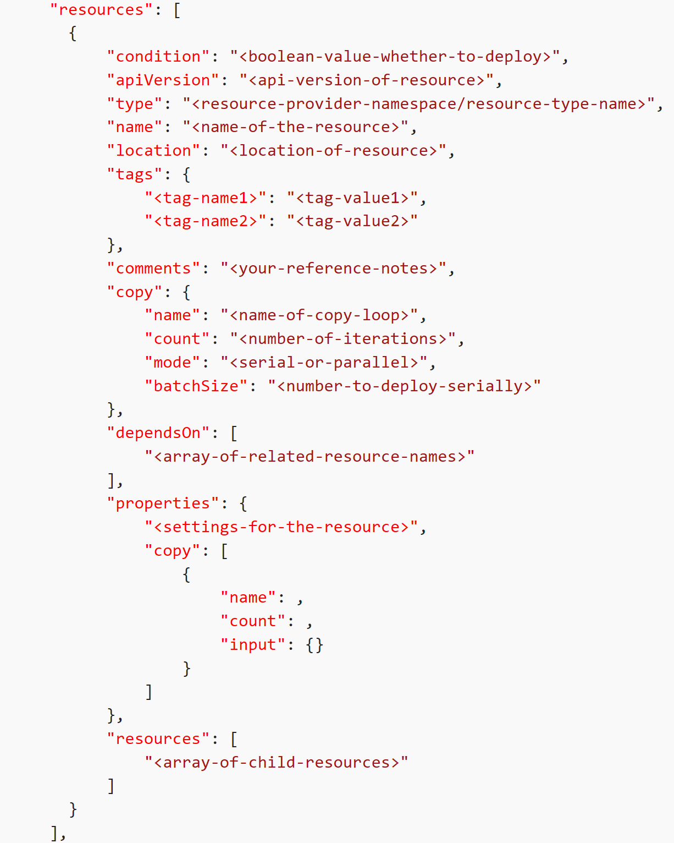
Resources

Slide 8
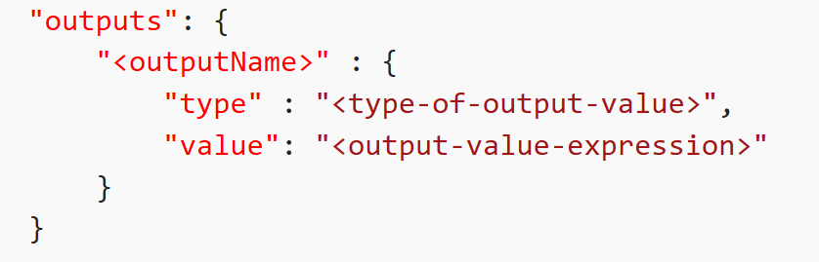
Outputs

Slide 9
Outputs

Slide 10
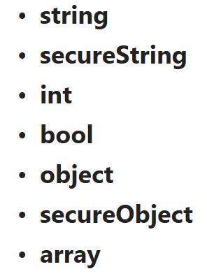
Data Types

Slide 11
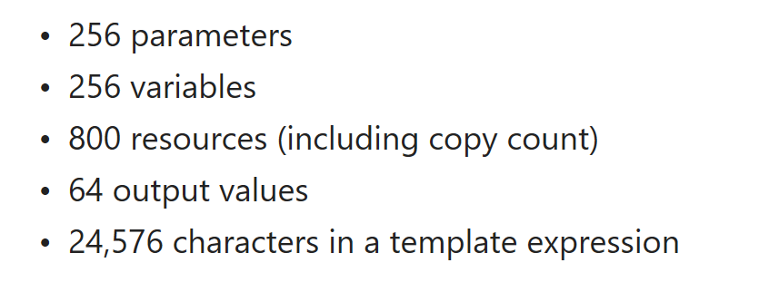
Template Limits

Slide 12
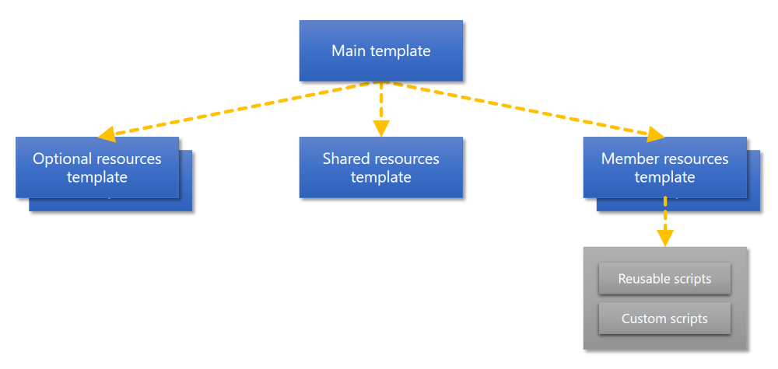

Slide 13
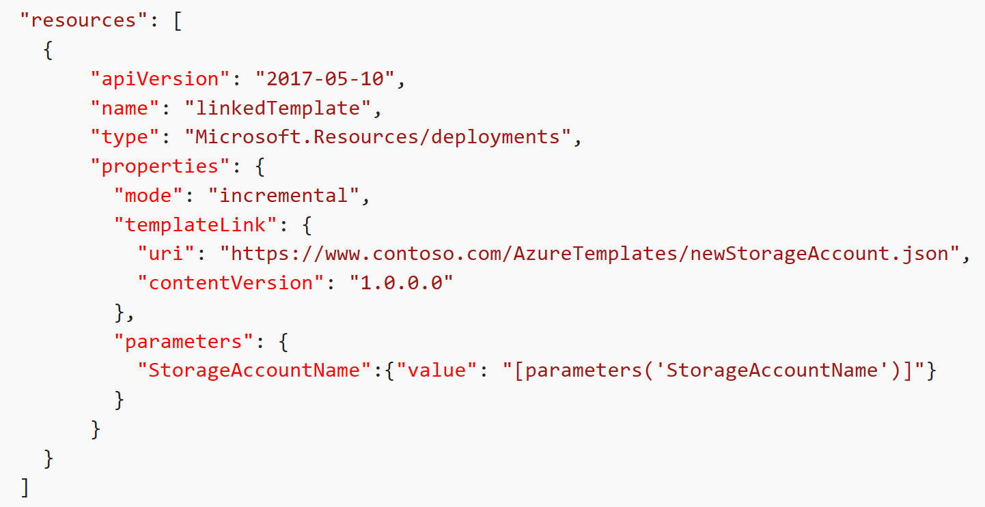
Linking Templates

Slide 14
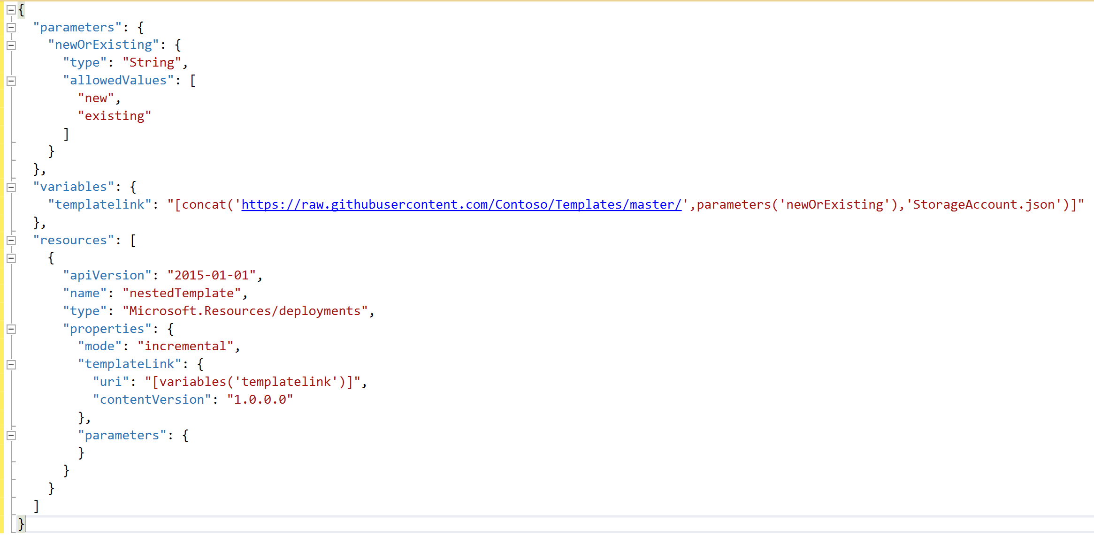
Conditional Deployment

Slide 15
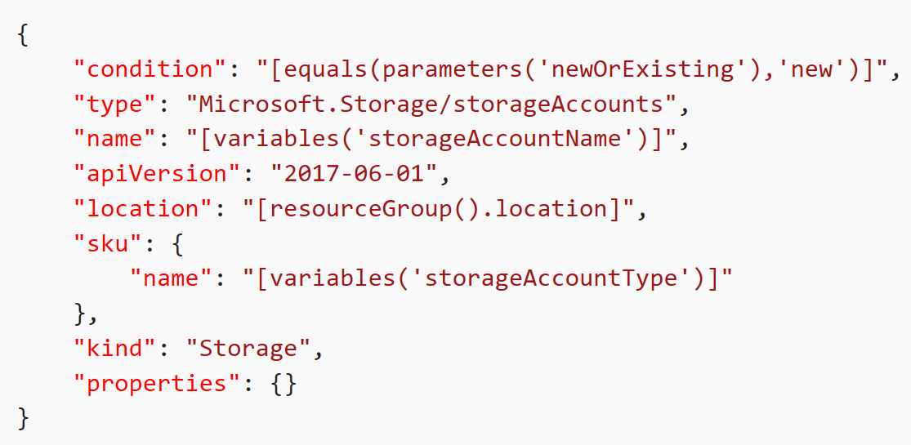
Conditional Deployment

Slide 16
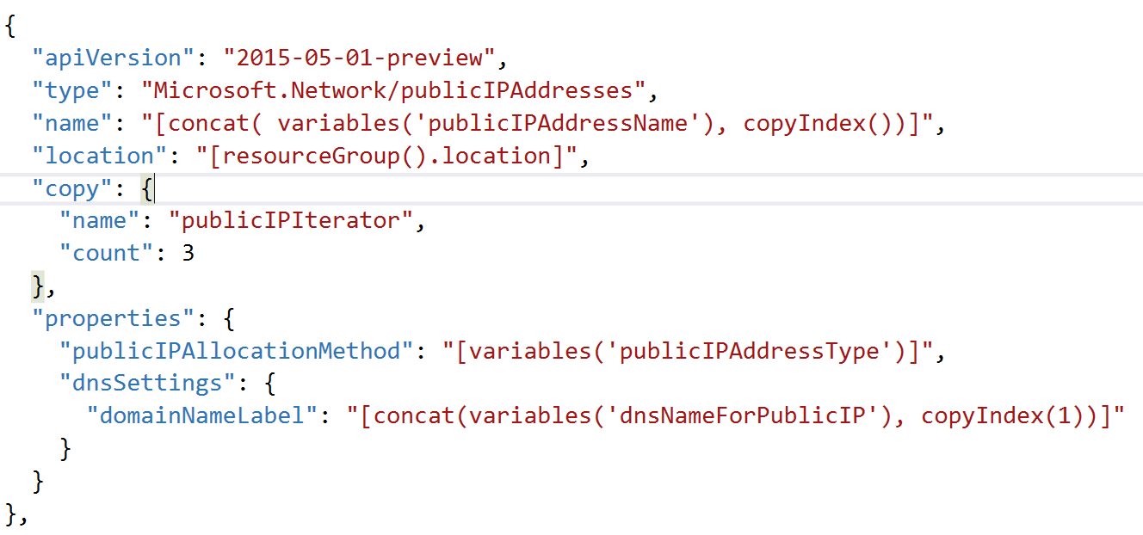
Copy Resources

Slide 17
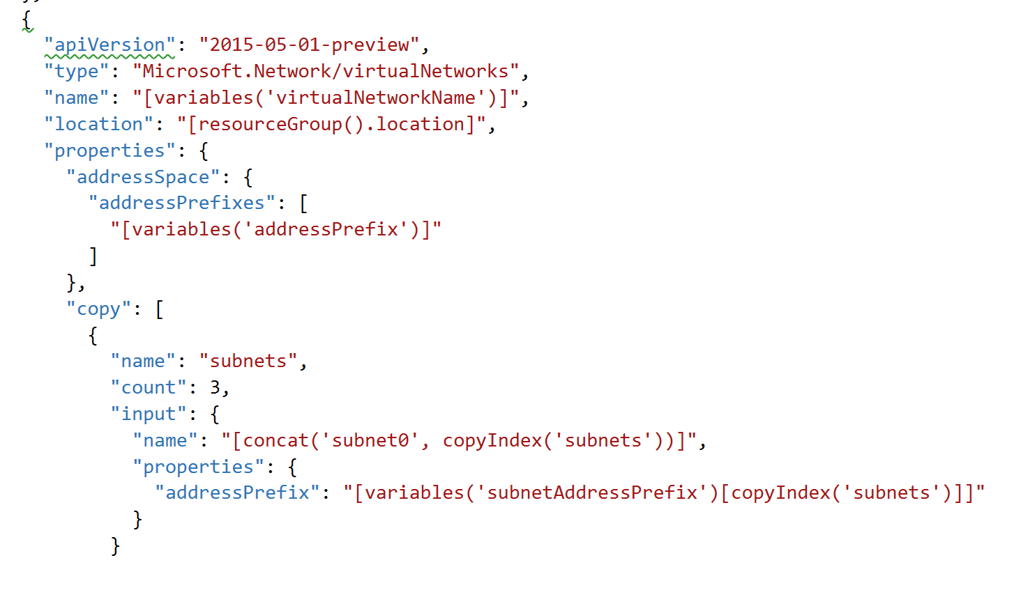
Copy Properties

Slide 18
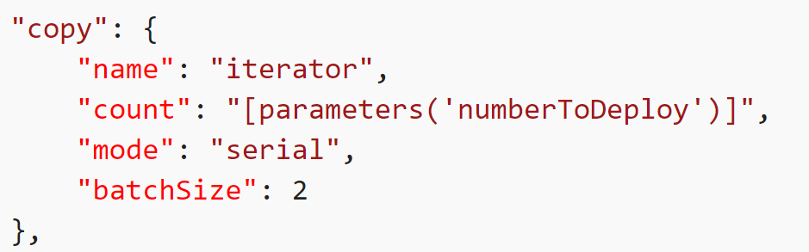
Sequential provisioning

Slide 20
Best Practices and other design elements
Schema version
Custom Script Extensions
Re-configure resources
Naming conventions
Tags
Dependson
Incremental vs Complete
Security

Slide 21
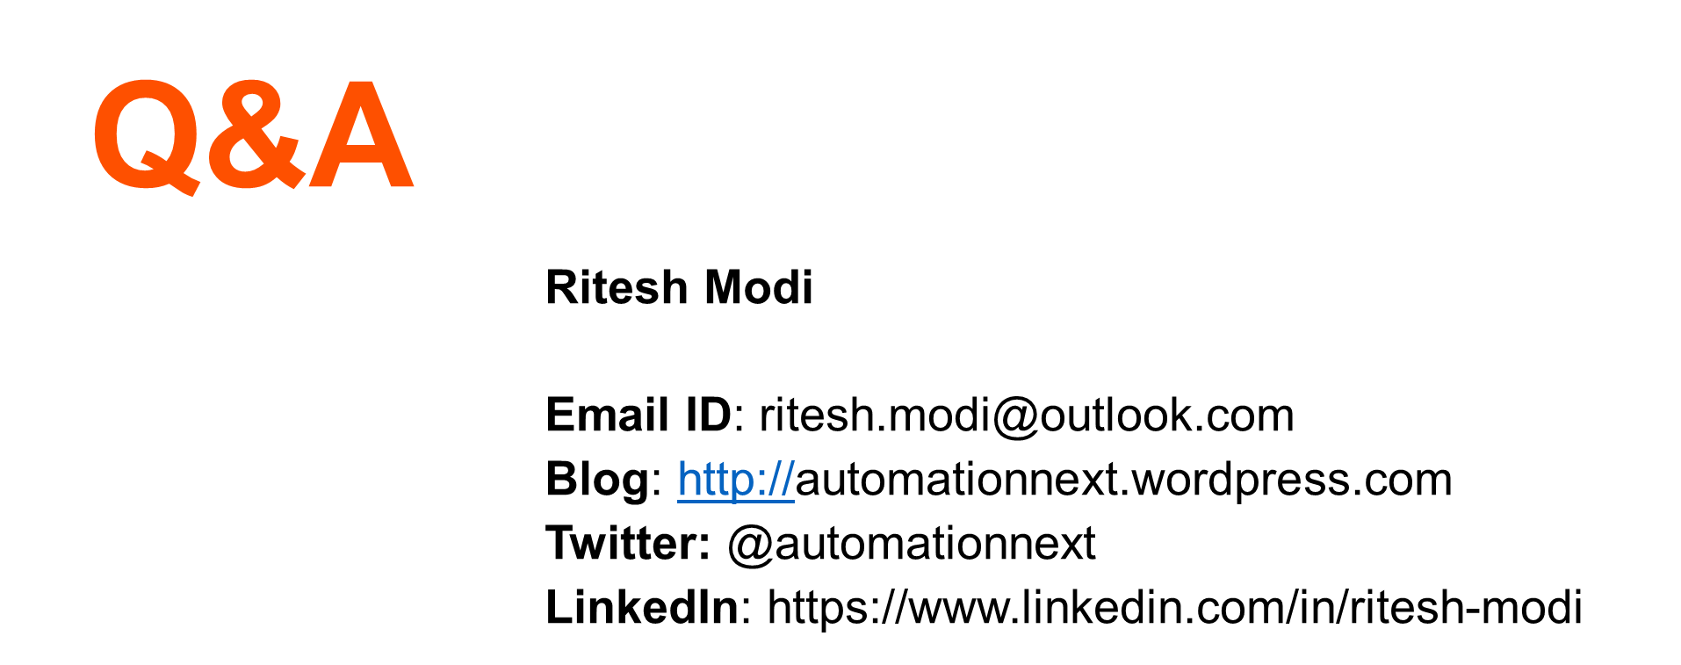

Slide 22
Don’t Forget!
Fill in your survey in Mobile app – it’s how we do better!
Don’t lose you badge! You need it for the Social Events
Grab the Speakers for a chat – they all have time for you!
Let everyone know what they are missing on Social Media
#PowerShell
#PSConfAsia
Photos of Marina Bay Credit: Sebastian Szumigalski
PowerShell Conference
Singapore 2017

